Slide 1
Comparison of Success rates between two video laryngoscope systems used in a prehospital clinical trial

Slide 2
Introduction
Video Laryngoscopy (VL) has been proposed as an ideal approach to difficult airways.
Better visualization of vocal cords.
Ideally more successful ETT placement.
To date, no clinical trial has compared success rates between two video laryngoscopes in a non-simulation setting.

Slide 3
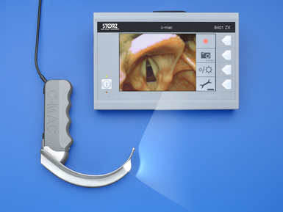
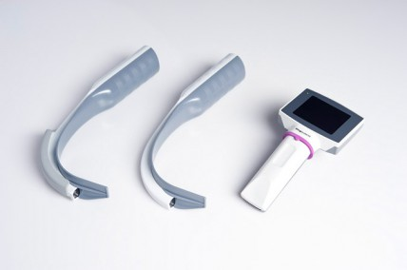
Introduction
CMAC
King Vision

Slide 4
Methods
Study Design
IRB-approved, multiagency, prospective, prehospital, nonrandomized, crossover trial comparing paramedic success rates for two VL systems.
Setting
Four agencies providing 911 service.
One urban, fire-based, full-time paid, single-tier.
Two suburban, fire-based (one on-call, one full-time paid).
One suburban, hospital-based, full-time paid.
Devices placed in the six highest-volume intubating units.

Slide 5
Methods
Intervention
CMAC is a three piece device which can be used to perform DL in the event of monitor failure. Has recording capabilities.
King Vision is a two piece device with a disposable blade. Does not record.
Data Analysis
Patient and provider demographics for equality between groups.
First attempt success, overall success, success by attempt.
Call type (medical vs. trauma).
Cormack-Lehane score.

Slide 6
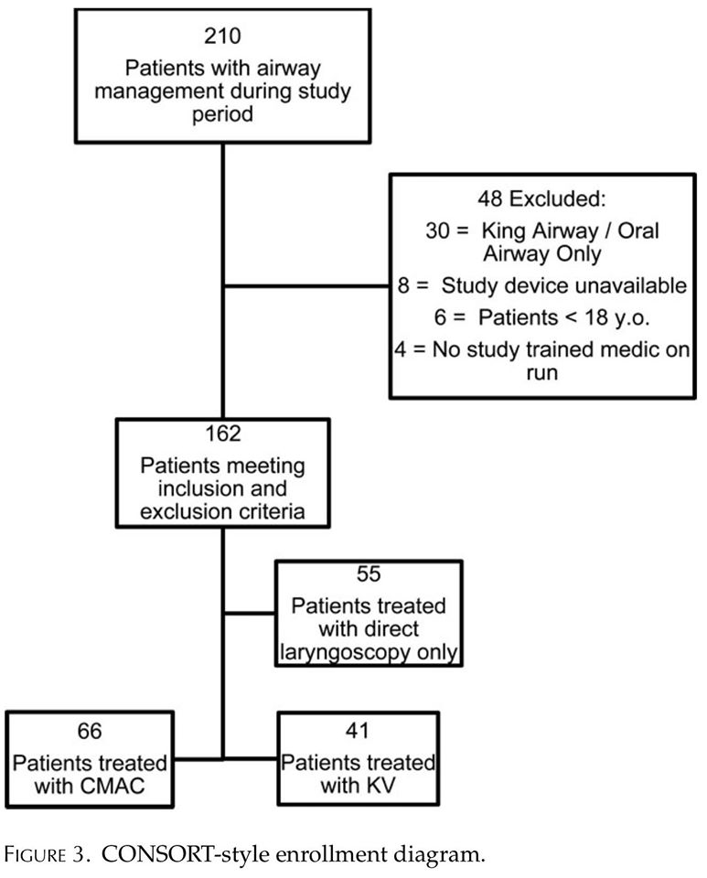
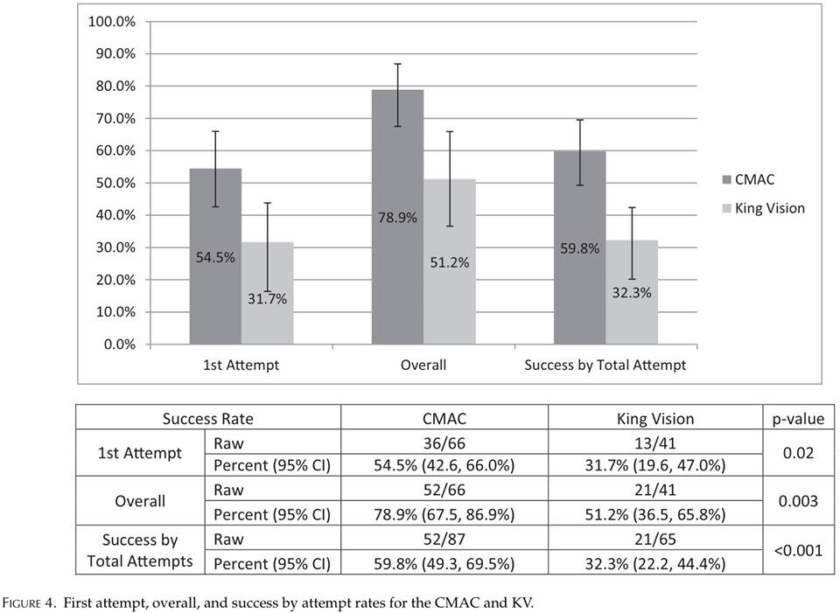
Results

Slide 7
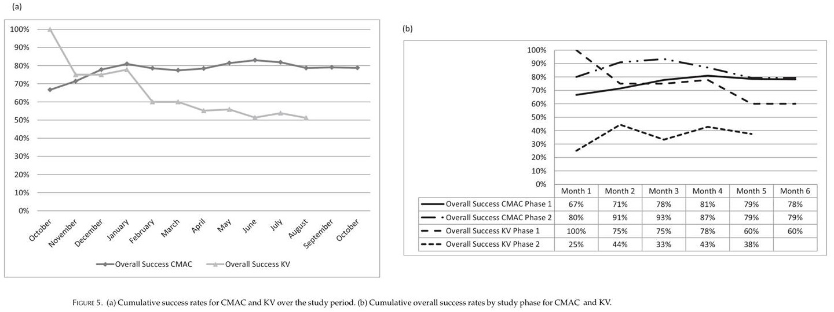
Results

Slide 8
Discussion
CMAC
Handle and grip similar to DL.
Without display, can be used as Mac-3.
May have been used as DL during study.
Lower success rate in med flight.
King Vision
Removal of disposable blade led to connection interruption with screen.
Grip is higher with hand closer to the screen.
12% of placements resulted in screen being detached by upward pressure.
ETT must be rotated into trachea, requiring remedial training.
Steady decline in success rates until stopped
All patients successfully intubated by DL or managed with BLS airway.

Slide 9
Discussion
The CMAC had a much higher success rate while complications were not statistically different.
Attempted to even out statistics by noting complications, experience of paramedic, comparison to other areas and other factors.
VL results were not statistically higher than historical DL.

